Slide 1


Histopathological Classification
Joanna Wiekiera, Martyna Żur

Slide 2

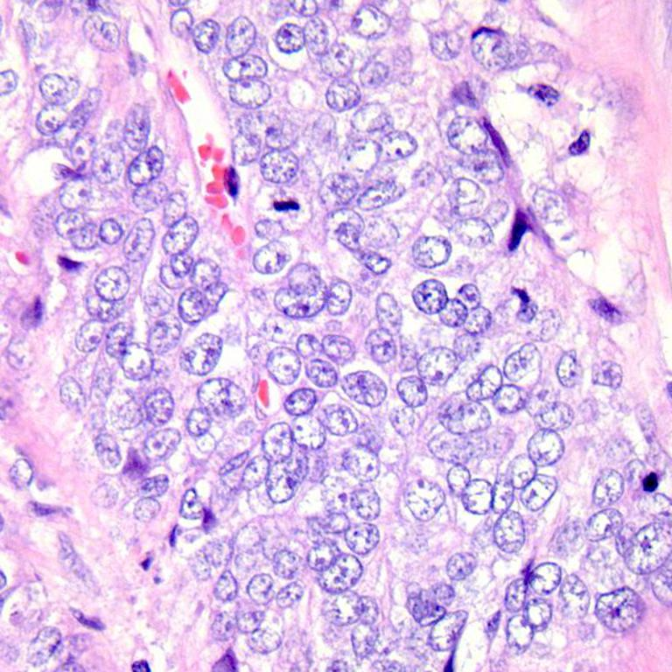
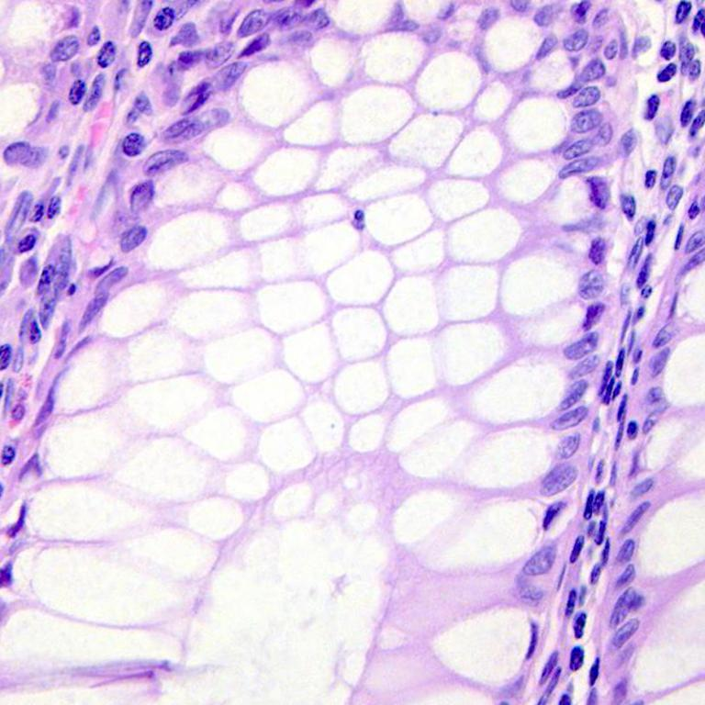
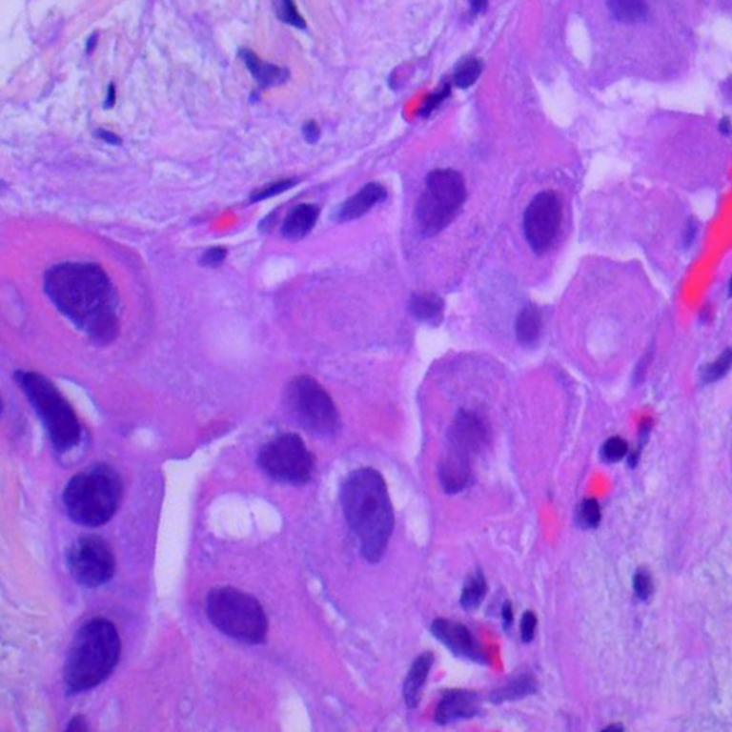
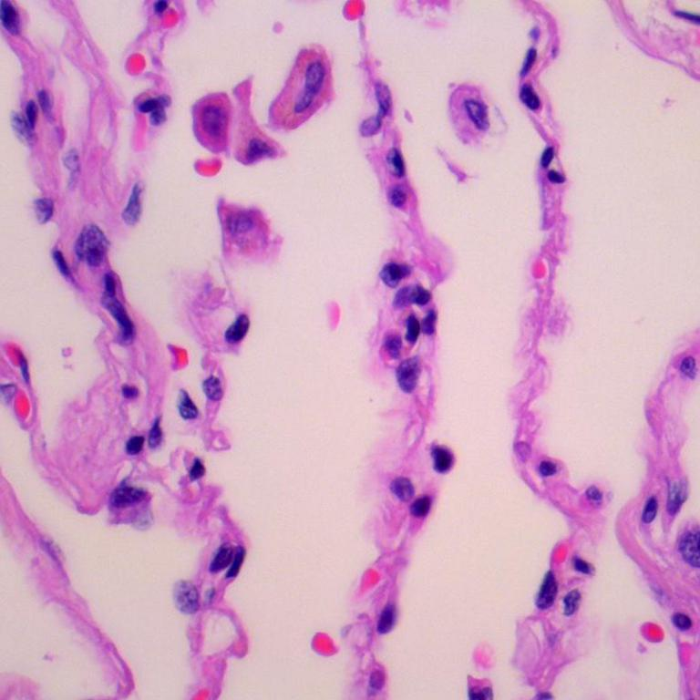
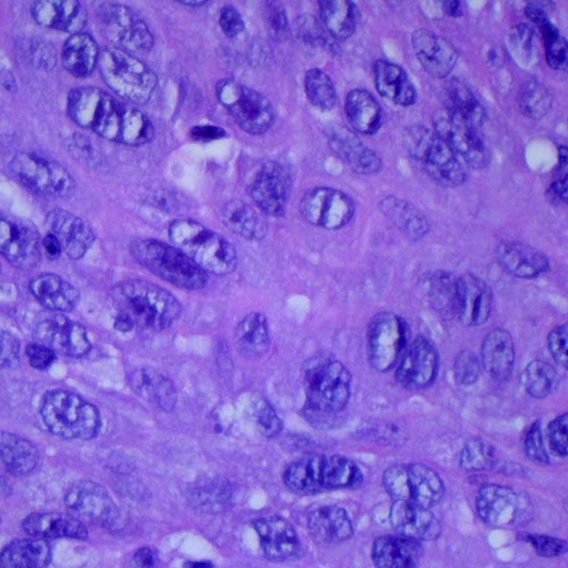
INPUT DATA
Aim of this project is to distinguish five classes:
Colon adenocarcinoma
Colon benign tissue
Lung adenocarcinoma
Lung benign tissue
Lung squamous cell carcinoma

Slide 3
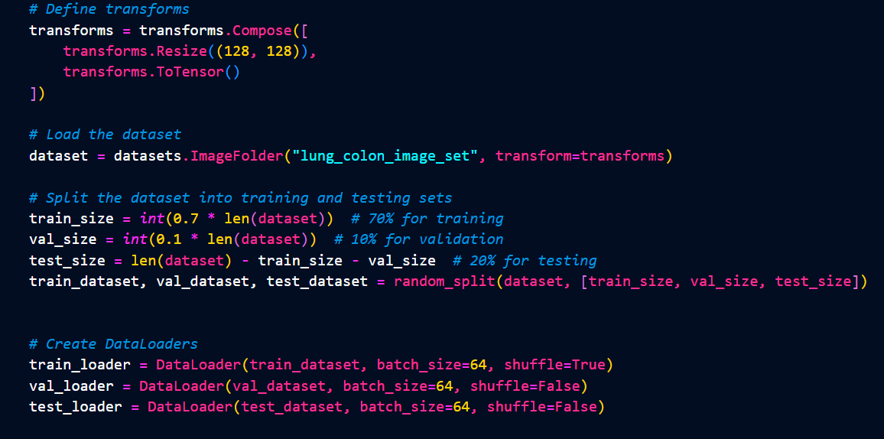
DATA PREPROCESING

Slide 4
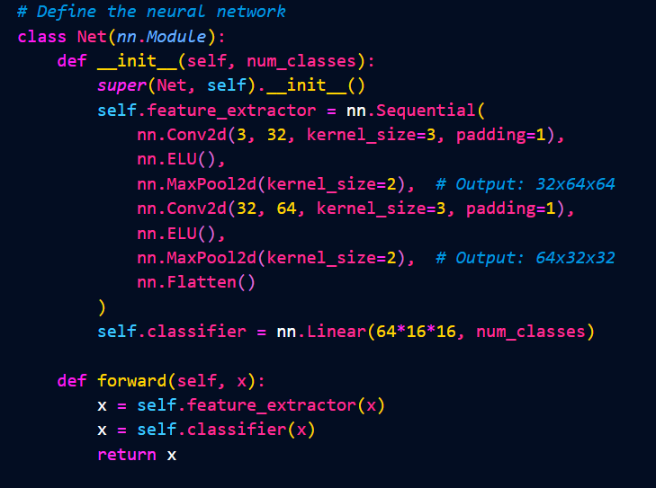
CONVOLUTIONAL NEURAL NETWORK

Slide 5
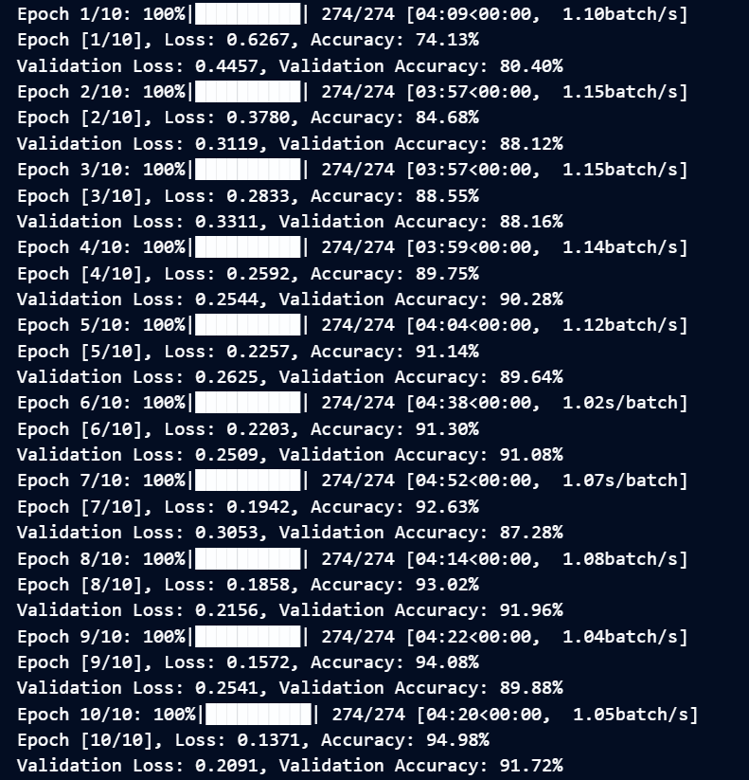

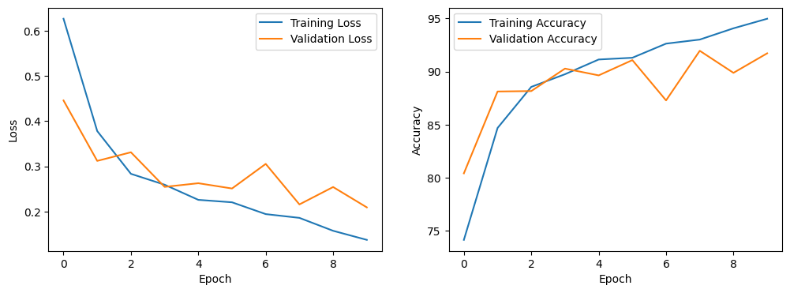
CONVOLUTIONAL NEURAL NETWORK

Slide 6
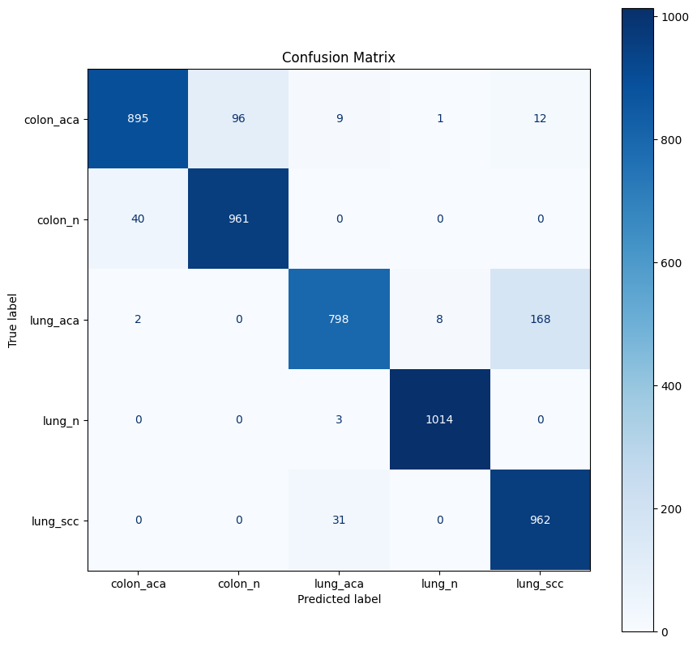
CONVOLUTIONAL NEURAL NETWORK

Slide 7
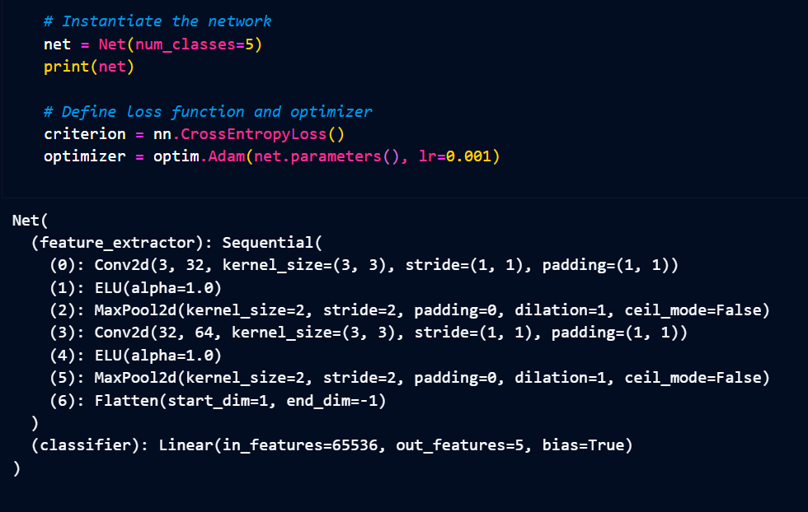
DATA PREPROCESING

Slide 8
TRAINING

Slide 9
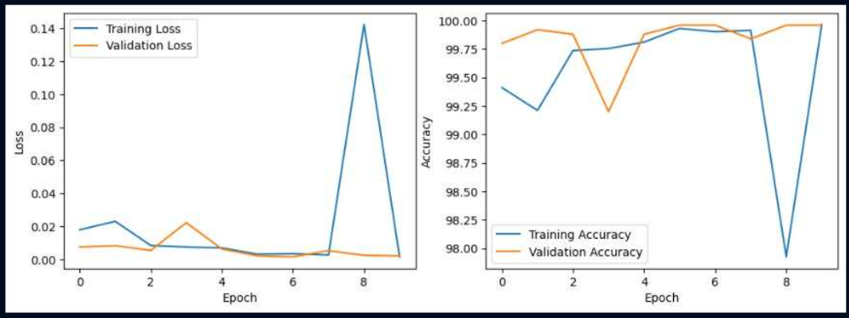
RESULT

Slide 10
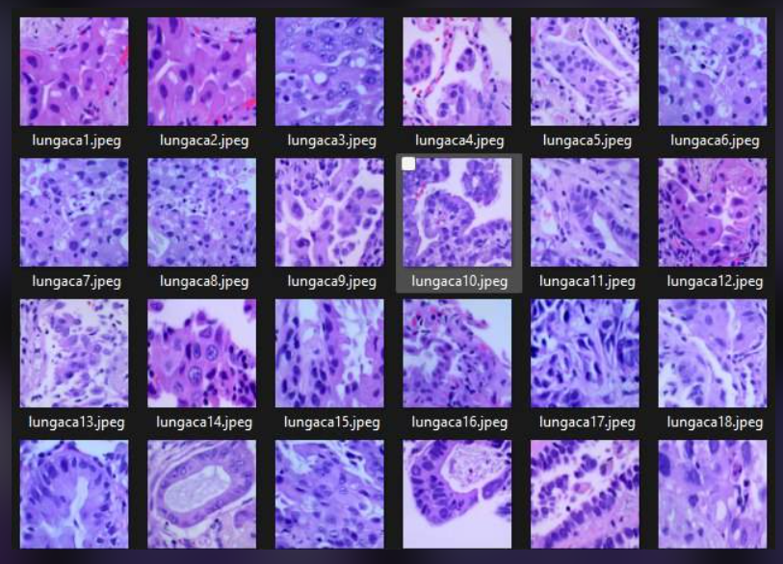

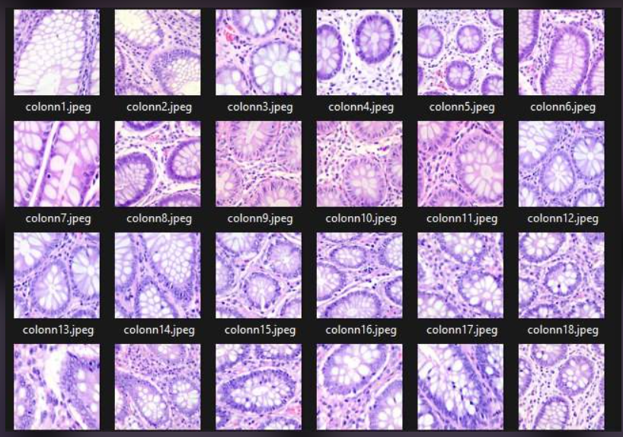
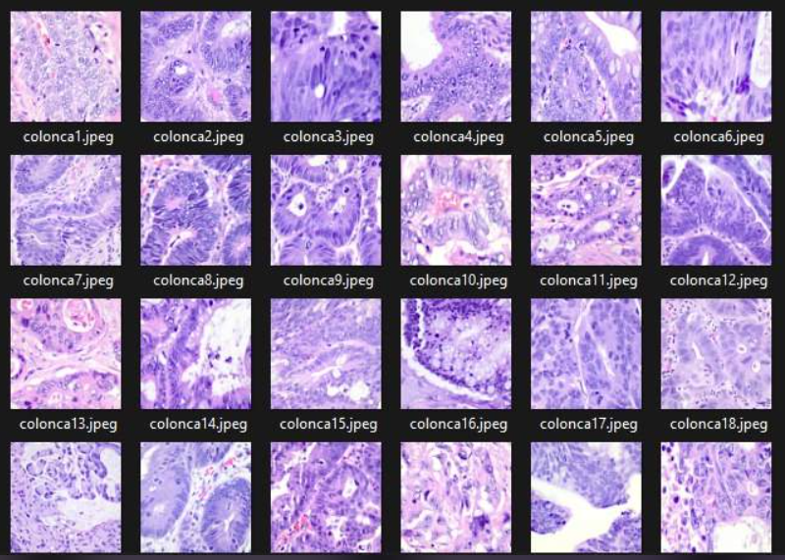
CONCLUSION
OUR DATE:
Training loss
Validation loss

